Slide 1


Movie Data Analysis
Data Analysis Project

Slide 2
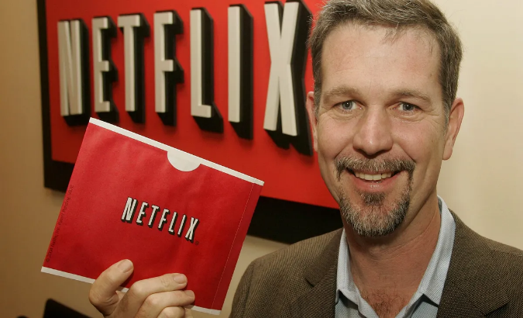
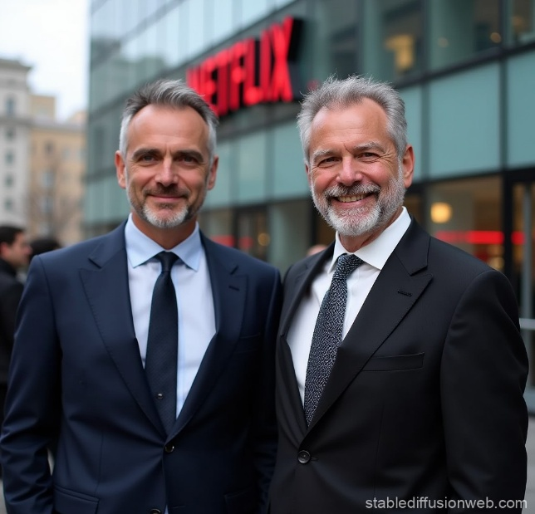
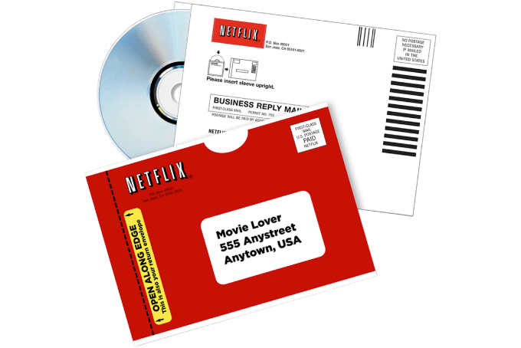
Netflix Movie Data Analysis Project
Netflix, founded on August 29, 1997, in Scotts Valley, California, by Reed Hastings and Marc Randolph, began as a DVD-by-mail service. Hastings, a computer scientist and mathematician, co-founded the company after being inspired by a hefty late fee from a traditional video rental store. Randolph, a marketing executive, played a pivotal role in shaping Netflix's early user interface and branding.

Slide 3
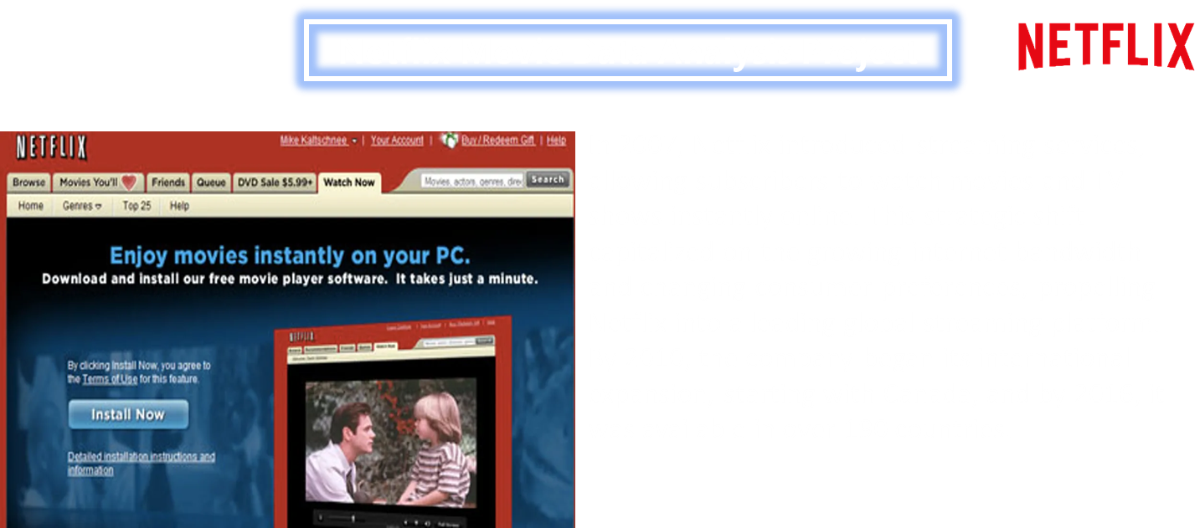

Slide 4
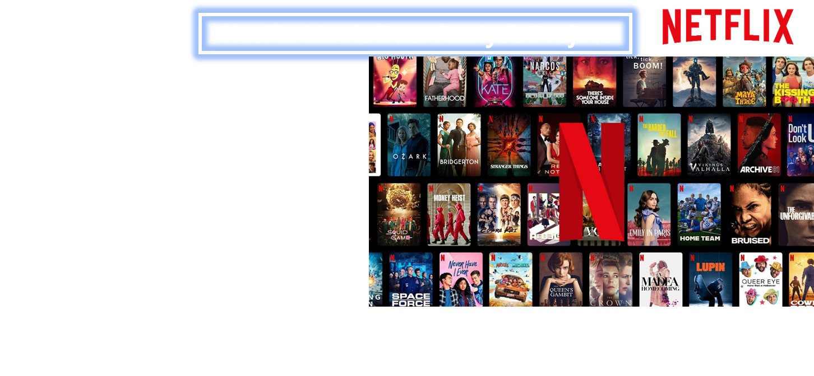

Slide 5
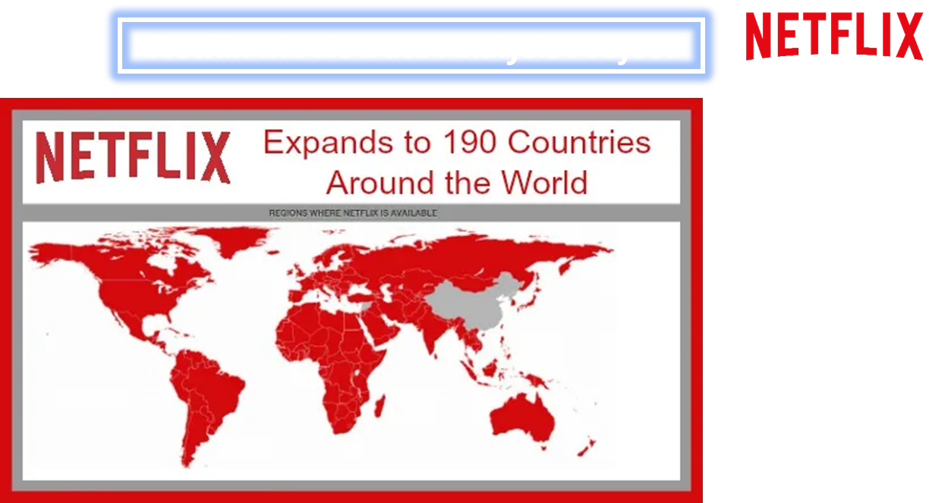

Slide 6
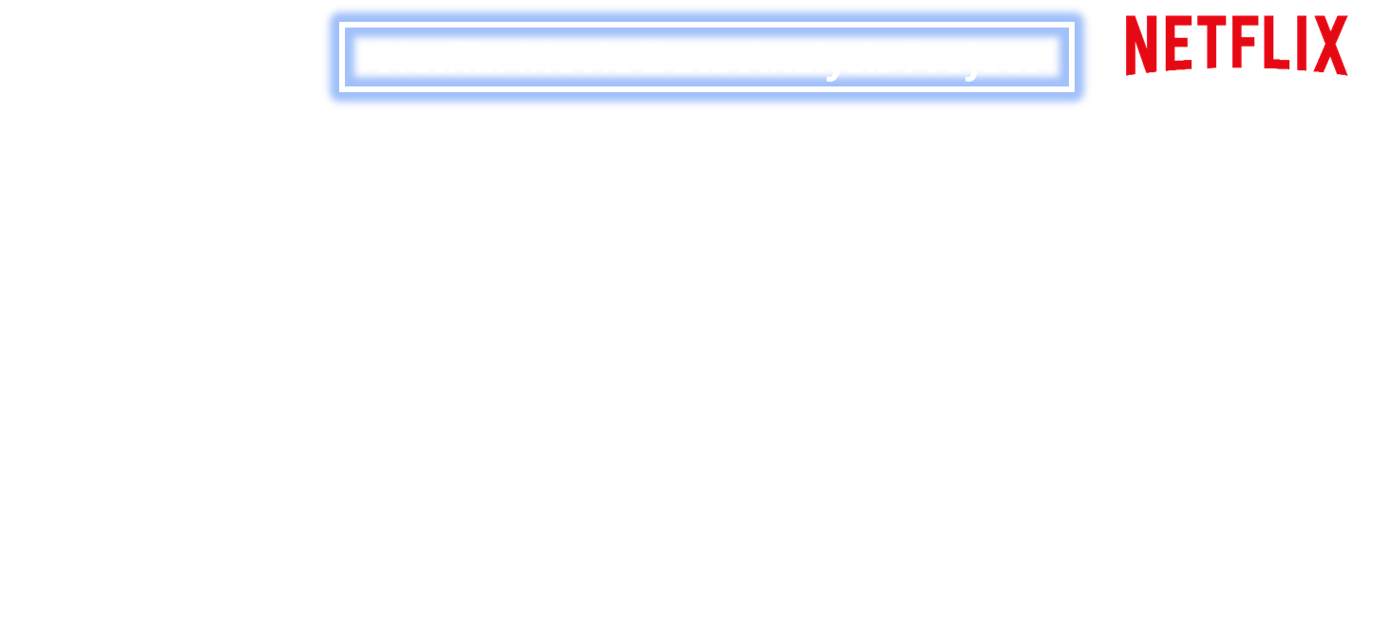

Slide 7
Thank You

